Slide 1
WPF containers
Windows Presentation Foundation

Slide 2
Containers: Panels
Absolute coordinates: Canvas
Stacking order:
StackPanel, DockPanel, WrapPanel
First come goes in the beginning
Proportional or rows / columns:
Grid, UniformGrid

Slide 3

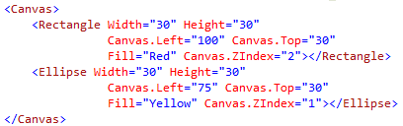

Canvas
Attached properties
Ordering: Canvas.ZIndex. Bigger => On top
Quiz:

Slide 4
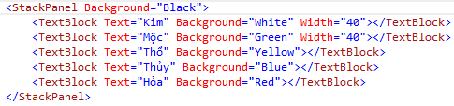
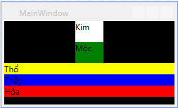
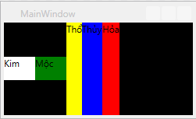
StackPanel
Default: Orientation=“Vertical”
Orientation=“Horizontal”

Slide 5
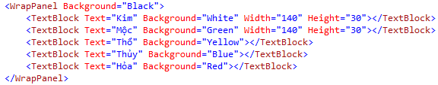
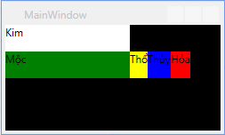
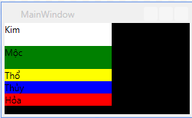
WrapPanel
Default: Orientation=“Vertical”
Orientation=“Horizontal”

Slide 6
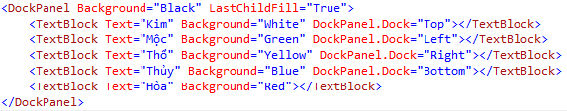
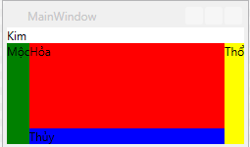
DockPanel
Why DockPanel? No relative position changes when zoom
LastChildFill!

Slide 7
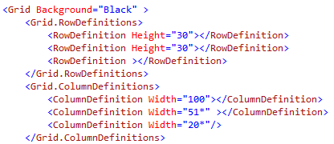
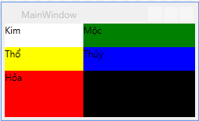
Grid
Most powerful layout container!
Arrange elements in a table-like layout
Predefined rows and columns

Slide 8

Grid - Positioning

Slide 9
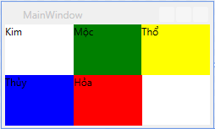
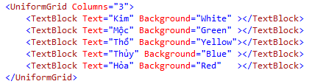
UniformGrid
All elements have same size
Fill elements based on rows / columns
FlowDirection: LeftToRight, RightToLeft

Slide 10
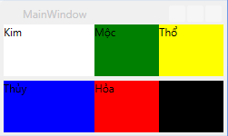
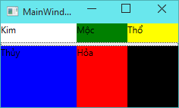
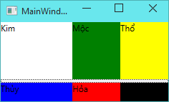
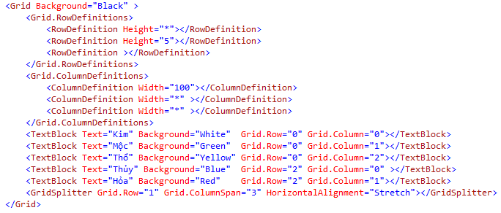
GridSplitter
Let user adjust layout

Slide 11
Sizing
Many properties
Width, Height
MaxWidth, MaxHeight
MinWidth, MinHeight
Padding, Margin

Slide 12
Tips – Auto size
HorizontalAlignment="Stretch“
VerticalAlignment="Stretch"

Slide 13
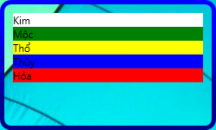
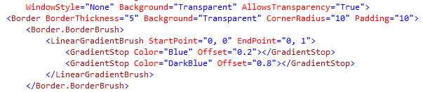
Border
Hold only one child element
Properties
BorderBrush
BorderThickness
CornerRadius

Slide 14
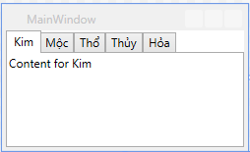
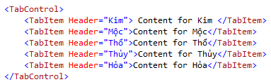
TabControl
Switching between multiple pages

Slide 15
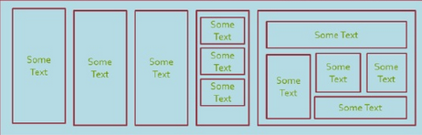
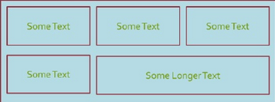
Activity
Write XAML code to create the following screens
Note: Don’t use Grid for everything!
1
2

Slide 16
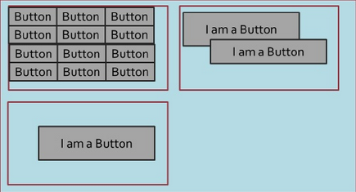
Activity – Cont.
3

